Slide 1


Math at Abingdon
Notes:
1:50 Estela

Slide 2
The Math Team
Math Coaches - Estela Tice and Kelly Penfield
Math Interventionists - Darcia Treadwell and Rachel Nesbitt
Contact

Slide 3
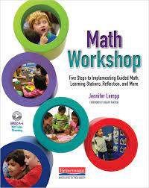
The Structure of Math Workshop (~75 min)
15 minutes | Number Sense Routine (Warm-Up)
20 minutes | Focus Lesson (Whole Class)
30 minutes | Guided Math (Small Groups) | Stations (Partner Work and Choice)
10 minutes | Reflection (Whole Class)

Slide 4
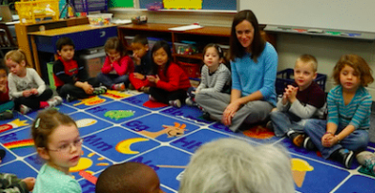
Number Sense Routines
Notes:
Discourse, flexing your math muscles, think time

Slide 5
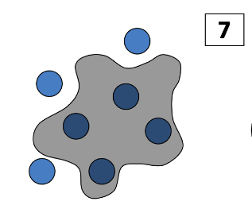

Splat!

Slide 6
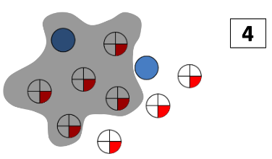

Splat!
Intermediate

Slide 7

Focus Lesson
Notes:
Minilesson

Slide 8
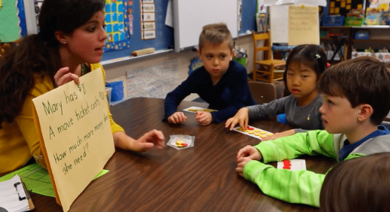
Guided Math - Small Groups
Notes:
Tier 2

Slide 9
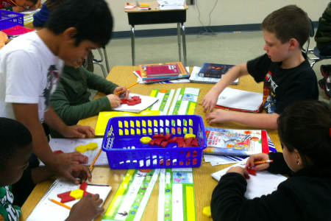
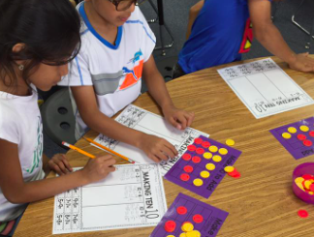
Learning Stations & Choice
Notes:
Tier 2

Slide 10






My Math Choices
Must Do!
When I’m done...
2 lessons
A class was asked, what is their favorite sport? This is what they shared.
4 students liked soccer.
6 students liked basketball.
3 students liked dance.
On your whiteboard, use tally marks to fill in the table.
Soccer | Basketball | Dance
Notes:
Lower grade example

Slide 11
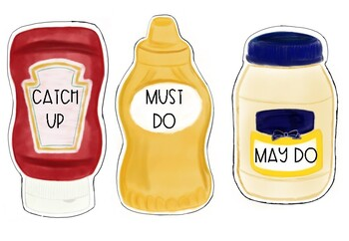


Math
1 | Must Do: Quick Check
2 | May Do: Dreambox or Reflex Review Game
3 | Catch Up: Math Review
Small Groups:
Notes:
Upper grades

Slide 12
Reflection
How can we support math at home?
Notes:
Why?

Slide 13
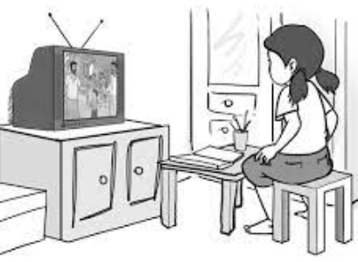
At Home Example
Television Time
Show 20 min | Commercial 10 min

Slide 14

Want to know more?
APS Math Program overview
More about Math Workshop
Math Resources for Parents
Help your child learn math
(from Department of Education)
APS Math Contacts

Slide 15
Abingdon Math Team Contact Information
Estela Tice (Math Coach)
estela.tice@apsva.us
Kelly Penfield (Math Coach)
kelly.penfield@apsva.us
Darcia Treadwell (site interventionist) darcia.treadwell@apsva.us
Rachel Nesbitt (central office interventionist) rachel.nesbitt@apsva.us

Slide 16
Parking Lot

